Slide 1
Blue Shift
An orbital mechanic based space racer

Slide 2
Game overview
Time trial racing game
Orbital Mechanics allowing for interesting track design
Checkpoints guide players through a fairly open track
Inspired by Outer Wilds

Slide 3
Getting around
Celestial bodies attract the player’s ship according to Newton’s Law of Gravitation
Players control the ship with 3 axis of movement and 1 axis of rotation.
Vertical axis might not be included depending on complexity.
Players optimize their time by performing gravity assist turns around celestial bodies.
The game will primarily be tested and recommended for controller play due to the complexity of the controls.

Slide 4
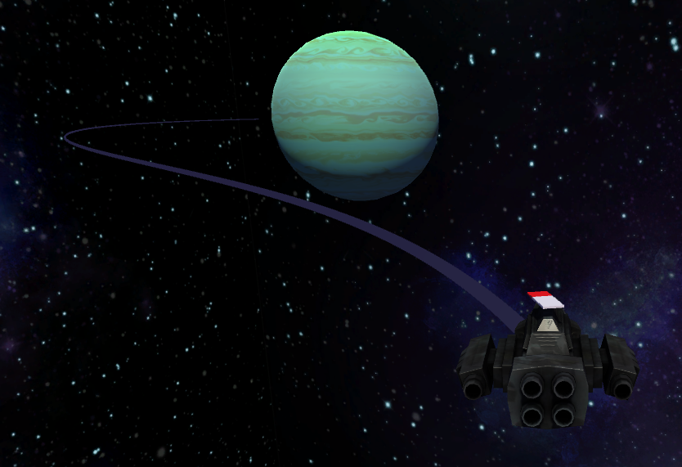
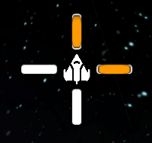
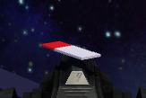
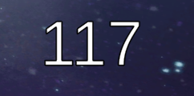
Helpful UI
1
Orbital path indicator
Thrust indicator
Compass pointing to next checkpoint
Current speed indicator
“Ghost” of previous best attempt (if any)
2
3
4

Slide 5
Track Design and Obstacles
Static celestial bodies
Moving bodies (asteroid belts, moons) - consistency per race is important
Sequential checkpoints Or choose your own path checkpoints
Track resets if a player collides with a static celestial body

Slide 6
Prototype 1
Included
2-axis movement and rotation
Orbital physics and static Celestial bodies
Thrust indicator
Orbital path indicator
Compass pointing in direction of velocity
Speed indicator
Basic test track with 3 celestial bodies
Not Included
Checkpoints
Compass pointing towards checkpoints
Racing timer and logic
Ghost racer
Moving celestial bodies
Different tracks

